Slide 1


BREAST CANCER PREDICTION
MACHINE LEARNING PROJECT
Made by:
TAMOUCHE Kaoutar
ZAIM Ibrahim
Suprivised by:
Pr. Soufiane Hamida

Slide 2


Plan
What are we discussing?
Breast Cancer and machine learning
Machine Learning Models
DATASET
WEB APP Dev

Slide 3


Introduction
1

Slide 4

Breast Cancer
What is breast cancer?
2

Slide 5

Problemmatic
Catching breast cancer early is crucial for effectively managing the disease.
-Importance of Early Detection?
3

Slide 6
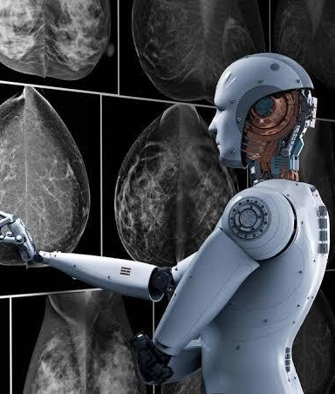
Role of Machine Learning in Early Detection
4

Slide 7
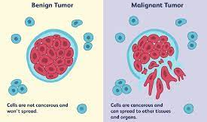
Dataset
The Breast Cancer Wisconsin (Diagnostic) Data Set, often referred to as the "Wisconsin Diagnostic Breast Cancer" (WDBC) dataset, is a popular dataset used in machine learning for the classification of breast cancer tumors into malignant or benign categories. It was created by Dr. William H. Wolberg at the University of Wisconsin Hospitals, Madison from 1989 to 1991.
5

Slide 8
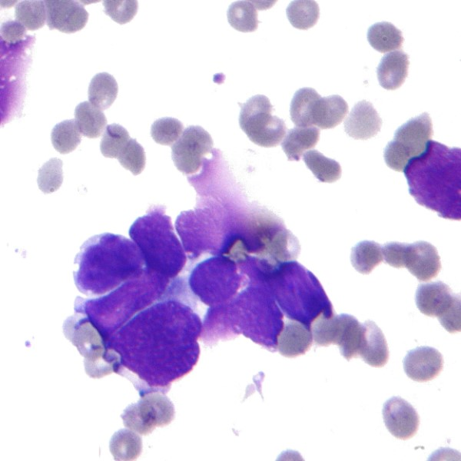
Data Exploration and Visualization
Data Cleaning
Data Transformation
6

Slide 9
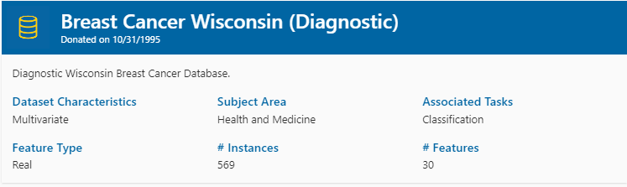
Data Exploration and Visualization
LETS VISUALIZE FIRST THE DATASET TO SEE WHAT WE HAVE
7

Slide 10
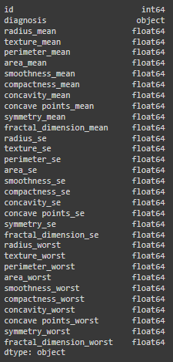
Data Exploration and Visualization
SEE THE DATA TYPES WE HAVE TO KNOW WHICH IS THE TAGRET AND WHICH ARE THE FEATURES
8

Slide 11
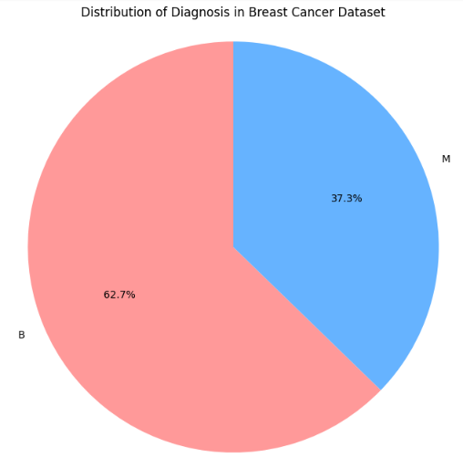
Data Exploration and Visualization
LETS NOW SEE THE THE DISTRIBUTION OF BENIGN (B) AND MALIGNANT (M) CASES IN THE BREAST CANCER WISCONSIN (DIAGNOSTIC) DATASET REPRESENTED BY THIS PIE CHART
9

Slide 12
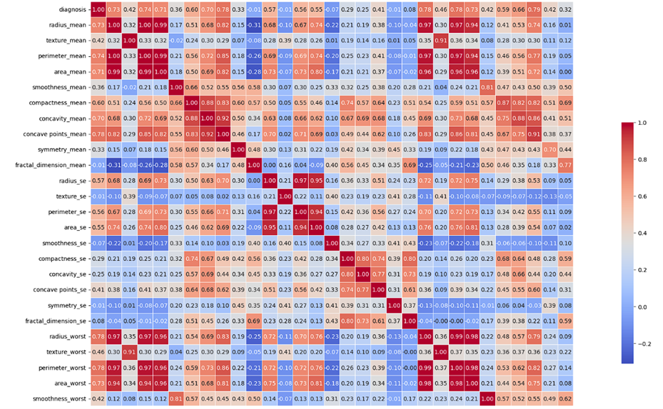
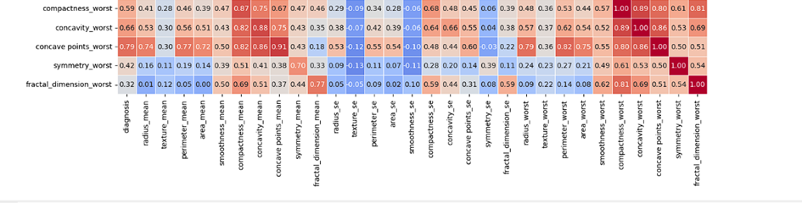
Data Exploration and Visualization
CREATING A HEATMAP OF CORRELATIONS USING MATPLOTLIB AND SEABORN FROM THE BREAST CANCER WISCONSIN (DIAGNOSTIC) DATA SET IS A VALUABLE STEP FOR UNDERSTANDING FEATURE RELATIONSHIPS
10

Slide 13
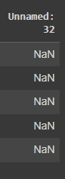
Dataset Cleaning
Remove the 'Unnamed: 32' column, which contains NaN values
Check is there is any missing data ( we will drop rows with missing data)
We dont need the id column because its not used as a feature for machine learning models since it's just an identifier.
11

Slide 14

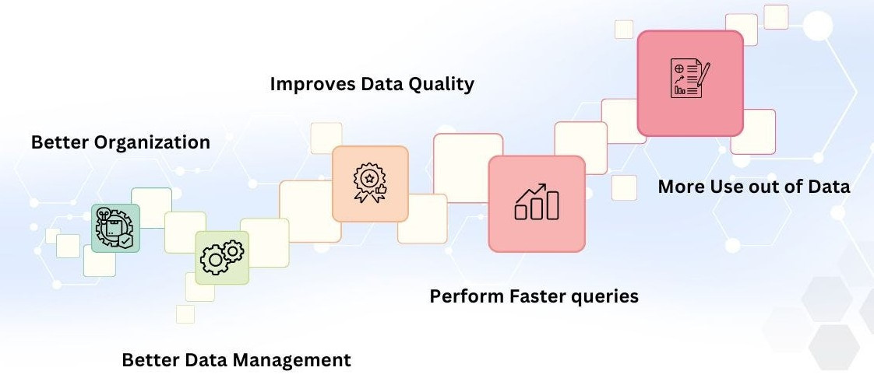
Data Transformation
12

Slide 15

Machine Learning Model
Machine learning models are algorithms that enable computers to learn from and make predictions or decisions based on data.
13

Slide 16
SVMs
Logistic Regression
SUPPORT VECTOR MACHINES (SVMS) ARE POWERFUL SUPERVISED LEARNING ALGORITHMS CAPABLE OF PERFORMING BOTH LINEAR AND NON-LINEAR CLASSIFICATION TASKS.
LOGISTIC REGRESSION IS A LINEAR CLASSIFICATION ALGORITHM THAT PREDICTS THE PROBABILITY OF AN OBSERVATION BELONGING TO A PARTICULAR CLASS.
14

Slide 17
KNN
Random forrests
K-NEAREST NEIGHBORS (KNN) IS A SIMPLE YET EFFECTIVE SUPERVISED LEARNING ALGORITHM USED FOR CLASSIFICATION AND REGRESSION TASKS. IT CLASSIFIES A NEW DATA POINT BASED ON THE MAJORITY CLASS OF ITS K NEAREST NEIGHBORS IN THE FEATURE SPACE.
RANDOM FORESTS ARE VERSATILE ENSEMBLE LEARNING METHODS THAT COMBINE MULTIPLE DECISION TREES TO CREATE A ROBUST PREDICTIVE MODEL. EACH TREE IN THE FOREST INDEPENDENTLY LEARNS TO PREDICT THE TARGET VARIABLE, AND THE FINAL PREDICTION IS DETERMINED BY AGGREGATING THE PREDICTIONS OF ALL TREES.
15

Slide 18

Logistic Regression
Confusion matrix:
TP
FP
Accuracy
0.9824
0.9841
Recall
106
2
FN
TN
0.9687
0.9763
F1 score
1
62
Precision
17

Slide 19
SVMs Evaluation
Confusion matrix:
Accuracy
0.9766
0.9682
Recall
106
2
0.9682
0.9682
F1 score
2
61
Precision
16

Slide 20
Random Forrests
Confusion matrix:
Accuracy
0.9707
0.9365
Recall
107
1
0.9833
0.9593
F1 score
4
59
Precision
18

Slide 21
KNN:
Confusion matrix:
Accuracy
0.9590
0.9365
Recall
105
3
0.9516
0.944
F1 score
4
59
Precision
19

Slide 22


FINAL MODEL CHOICE
20

Slide 23


WEB APP DEV
21

Slide 24
CONCLUSION
22

Slide 25
THANK YOU

